Slide 1

Radius Health Market Analysis for Osteoporosis

Slide 2


Background. Radius Health Releases TYMLOS
2017 – FDA approves TYMLOS to treat postmenopausal osteoporosis in the US
2021 – FDA approves the removal of some warnings of TYMLOS
Research Needs:
Which drugs are leading the market?
Who are the target demographics?
What are the market drivers?
What are the opportunities?
2
Notes:
TYMLOS is an injectable medication to treat postmenopausal osteoporosis

Slide 3
Approach and Methodology
Which drugs are leading the market?
Analyze current market data to identify the most prescribed drugs to treat osteoporosis.
Who are the target demographics?
Analyze current market data to identify the demographics of the users.
I
Data Analytics
What are the market drivers?
Analyze the medication reviews to identify what certain drivers lead positive reviews.
What are the opportunities?
Analyze the medication reviews to understand what the patients are looking for from their medications.
II
Language Model

Slide 4



About the Data
Dataset
12 Features
Data Preprocessing
WebMD Drug Reviews
Context:
The dataset provides user reviews on specific prescription drugs along with conditions, side effects, age, sex, and user rating reflecting overall patient satisfaction.
Source: https://www.kaggle.com/datasets/rohanharode07/webmd-drug-reviews-dataset.
Size: 362,806 x 12
Drug (categorical): name of drug
DrugID (numerical): drug id
Condition (categorical): name of condition
Review (text): patient review
Side (text): side effects associated with drug (if any)
EaseofUse (numerical): 5 star rating
Effectiveness (numerical): 5 star rating
Satisfaction (numerical): 5 star rating
Date (date): date of review entry
UsefulCount (numerical): number of users who found review useful
Age (numerical): age group range of user
Sex (categorical): gender of use
Restrict condition to osteoporosis
Remove duplicate reviews
Re-code the age to the desired buckets
4
Notes:
How can radius health displace the top3 = people are saying bad things about them too. Room to compete. Shows no one predominant drug. Room to displace the market.
One slide on TYMLOS about what people say about them.
Sloppiness on the data quality. Research condition, side effects, back ground info.
Sentence similarity on TYMLOS vs others.

Slide 5
Overview of Osteoporosis-related Illnesses
Conditions | Number of Reviews
Osteoporosis Osteoporosis in Male Patients Aromatase Inhibitor Drug-Induced Osteoporosis Osteoporosis in Men due to Deficient Function of Testis Post-Menopausal Osteoporosis Prevention Osteoporosis in postmenopausal woman at high risk for fracture Osteoporosis caused by Glucocorticoid Drugs Glucocorticoid-Induced Osteoporosis Prevention Osteoporosis caused by Anti-Androgen Drugs | Female: 1116 Male: 71 Unspecified: 170 Number of Unique Drugs: 71 Rating Records from 2007 to 2020
5

Slide 6
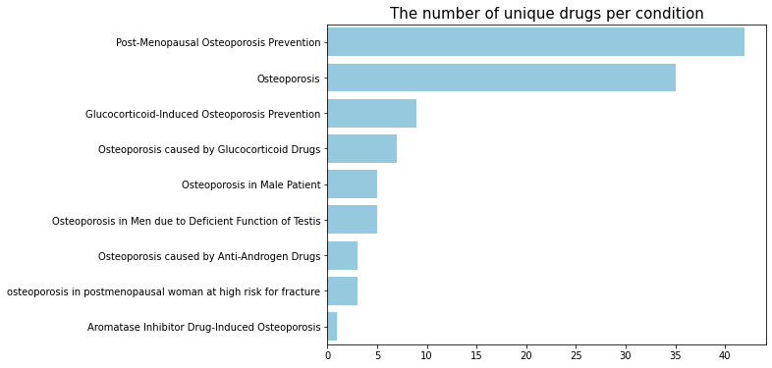
Most Treated Conditions
Post-Menopausal Osteoporosis Prevention and Osteoporosis had the most number of unique treatments.
TYMLOS treats Post-Menopausal Osteoporosis.
6

Slide 7
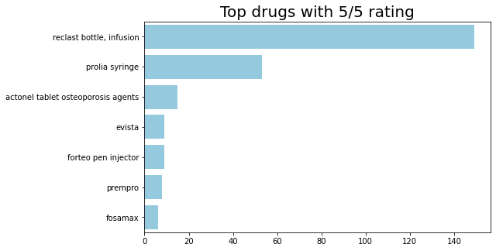
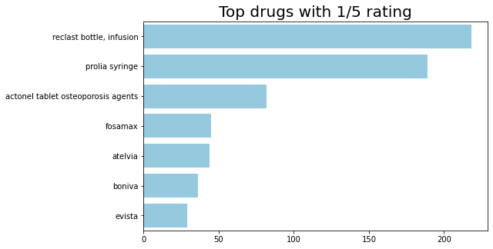
Best and Worst Drugs Based on Ratings
Observation:
Reclast Bottle, Prolia, and Actonel Tablet are top 3 for BOTH the best and the worst rated drugs.
7
Inconclusive: Difficult to identify the market leaders based on ratings

Slide 8
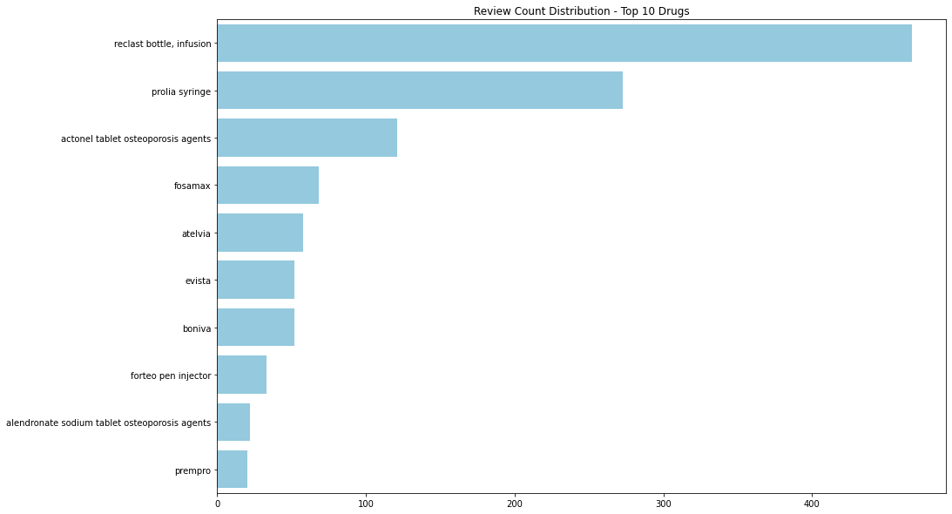
Top Medications Based on Number of Reviews
Assumption:
Amount prescribed is proportional to the amount reviewed.
8
Reclast Bottle (non-injectable) and Prolia (injectable) stand out as the most reviewed drugs.

Slide 9
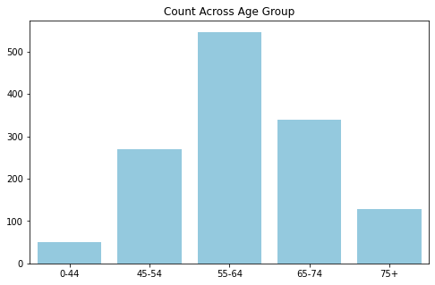
Target Demographics
Statistics:
82% of the patients are women.
Observation:
A large majority of the patients are from ages 45-74.
Conclusion:
Women in the ages 45-74 is the target demographic for Radius.
9

Slide 10
Most Treated Conditions
10

Slide 11
Most Treated Conditions
11

Slide 12
Summary Insights and Recommendations
12

Slide 13

Way Forward:
Language models to determine specific side-effects and its distribution among the different age groups.
Use of predictive modeling to obtain more fine grained product specific information.
(Are injectibles more favorable than non-injectibles?).
Further explore relationship between market share and aggregate quality of review for top osteoporosis medications.

Slide 14

Appendix

Slide 15
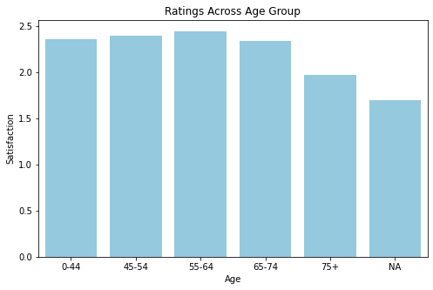
Frequency and Review Scores of Age Demographics.
Insights:
Frequency appears normally distributed over age, centered in the 55-64 age group while review scores are about uniformly distributed over age.

Slide 16
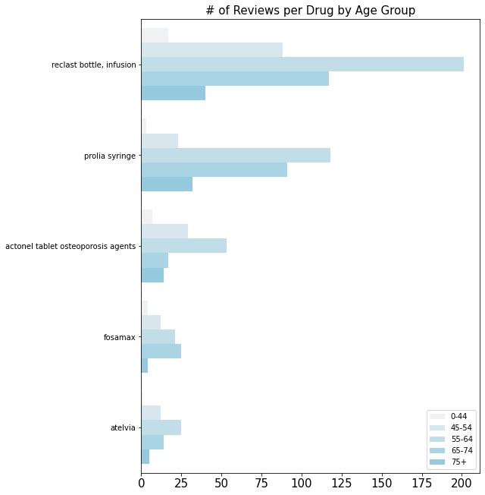
Frequency of Reviews for most Reviewed Medications.
Insights:
Frequency appears normally distributed over age, centered in the 55-64 age group while review scores are about uniformly distributed over age.

Slide 17
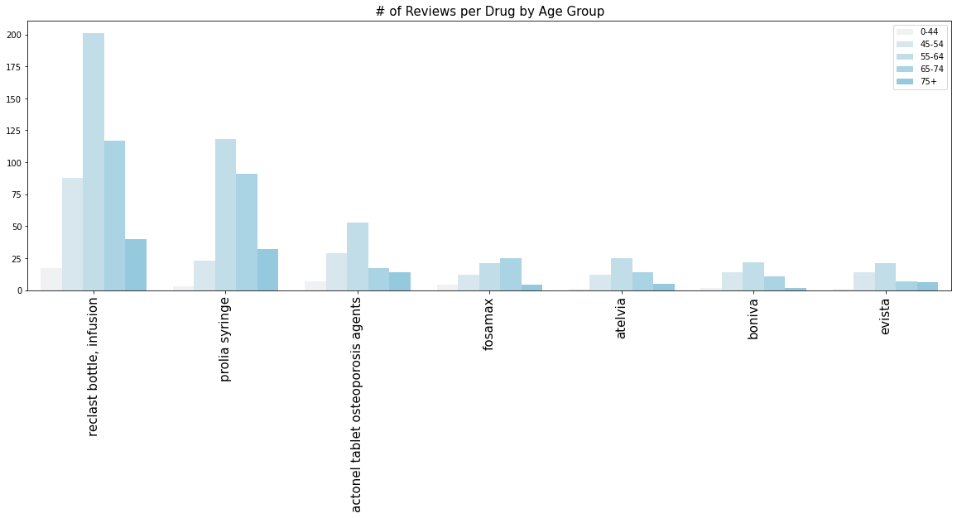
Frequency of Reviews by Age Group For Most Reviewed Medications
The age proportions remain constant across the most frequently reviewed drugs.
Notes:
One or two sentences, distinct color

Slide 18
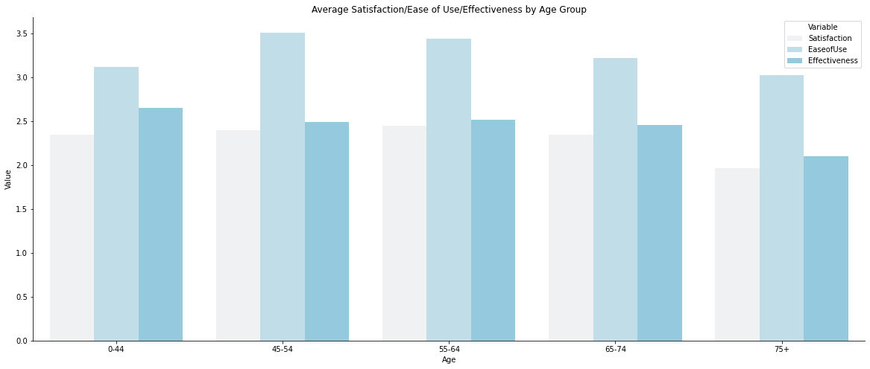
Average Ratings for Satisfaction, Ease of Use, and Effectiveness Across Age.
Insights:
There does not appear to be a major relationship between age and these three features.
Bullet 2

Slide 19
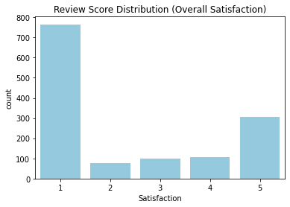
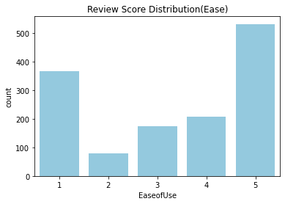
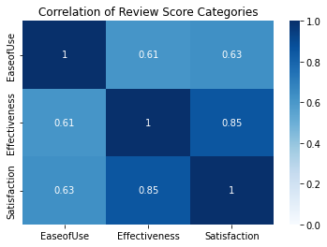
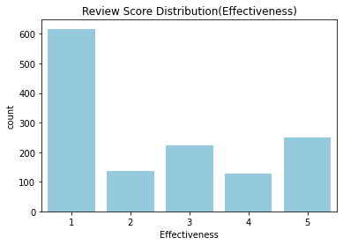
What is generally driving satisfaction? Ease of use or effectiveness?
1. Satisfaction is highly correlated with effectiveness. Moderately with ease of use.
2. Reviews tend to have higher ease of use ratings and lower satisfaction ratings.

Slide 20
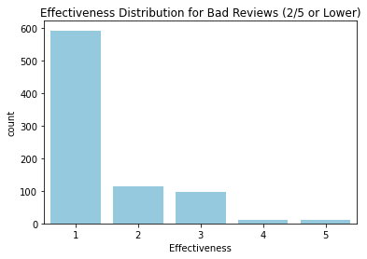
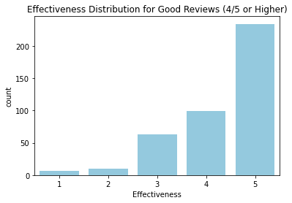
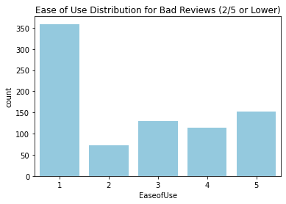
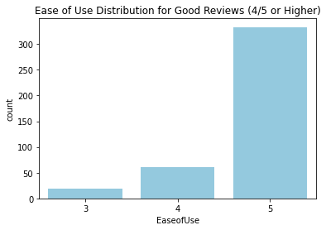
Good Reviews and Bad Reviews: What can we understand from the sub-categories?
1. Low effectiveness = Low satisfaction
2. Low ease of use = Low satisfaction
3. High effectiveness = High satisfaction
4. High ease of use ~ High Satisfaction (Weaker relationship)

Slide 21
Average Ratings for Non-injectable vs. Injectable Treatment: targeted at different age groups
Drug Name | Type | Count
Prolia Syringe Reclast bottle, infusion Zometa vial Atelvia Actonel tablet osteoporosis agents | Injectable Injectable Injectable Non-injectable Non-injectable | 545 148
Notes:
Split up info, direct attention

